Slide 1





Python - Powershell - SQL integration
https://github.com/adisirbu/SQL-Project-Public

Slide 2
Using multiple techniques and programming languages to achieve a desired data flow and storage.
Objective: obtain a database of regularly updated weather information (overall conditions, temperature, humidity and wind characteristics) for 5 Romanian cities in a totally automatic way.

Slide 3
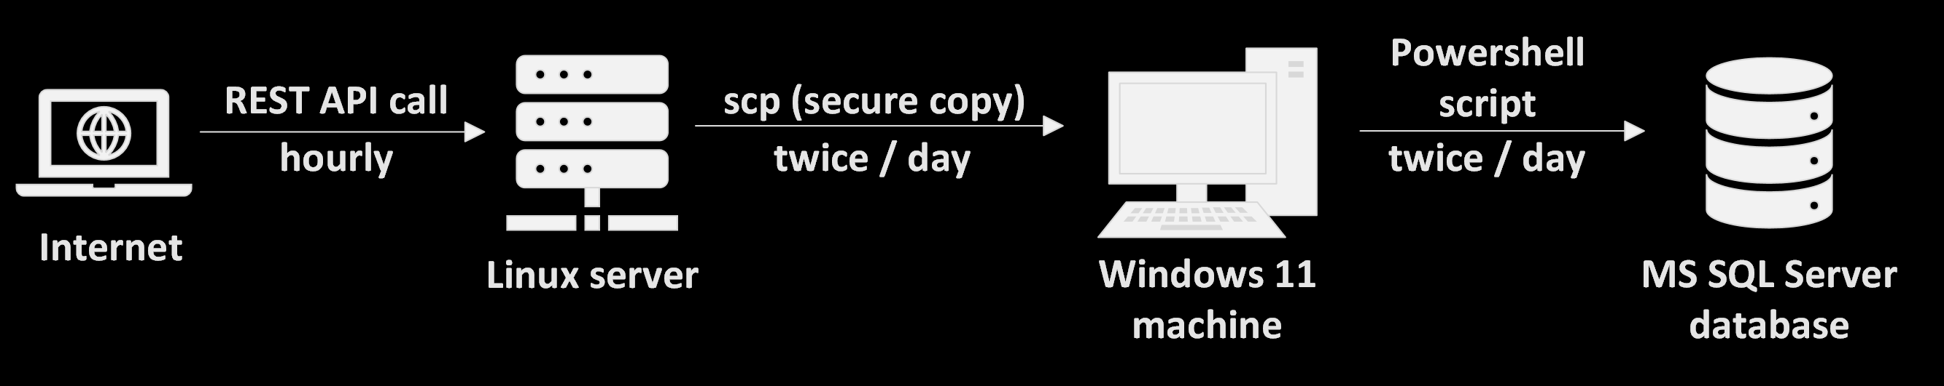
Using multiple techniques and programming languages to achieve a desired data flow
Data flow
Programming languages used: Python, Powershell and SQL
Techniques: REST API calls, passwordless scp (using SSH private – public key), Linux automation using crontab and Windows automation using Task Scheduler

Slide 4


1.
Linux server

Slide 5
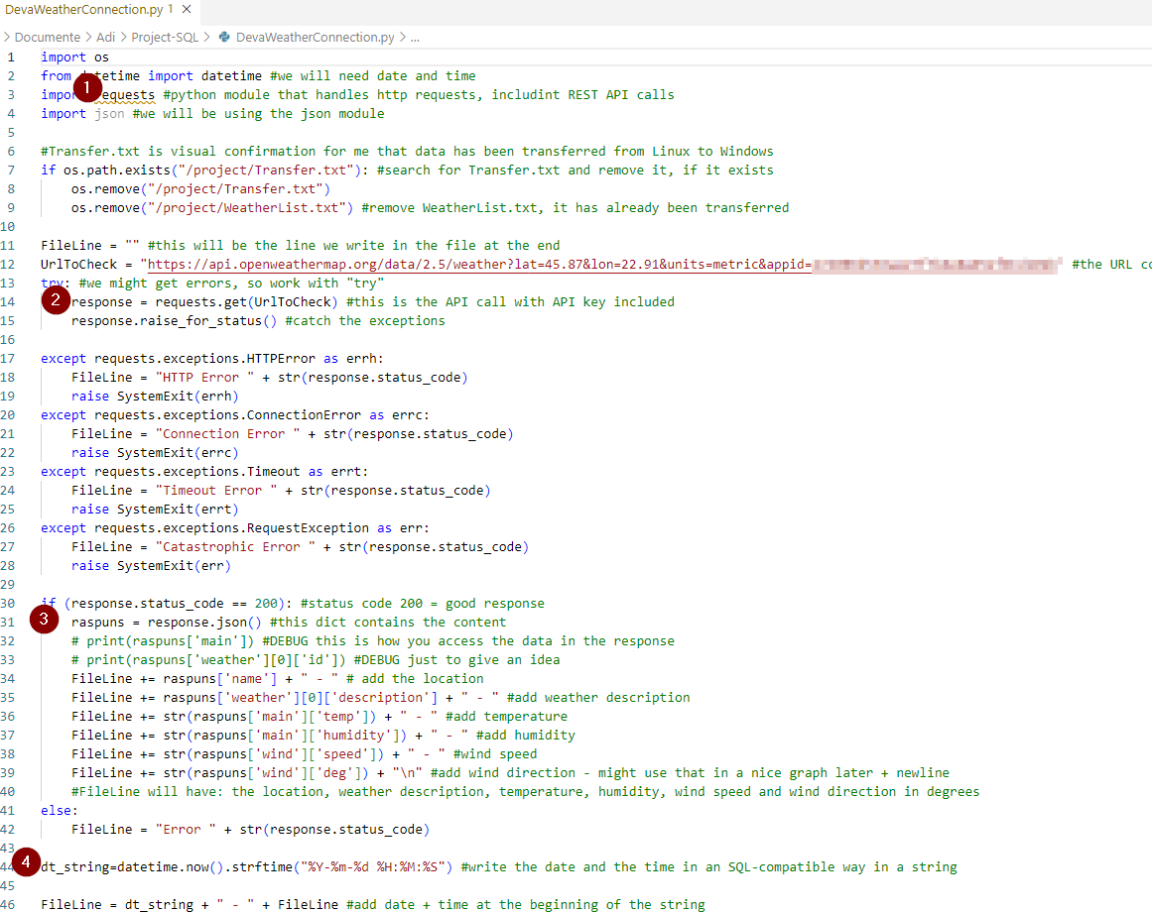
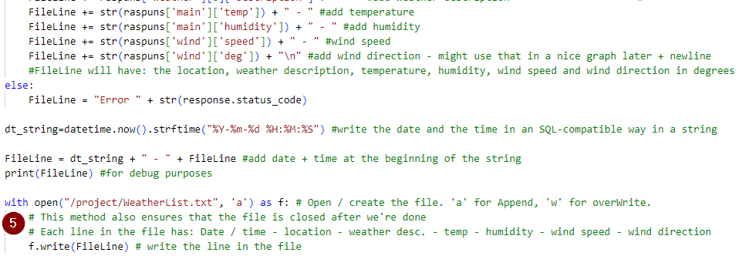
Python script sample: DevaWeatherConnection.py
1. You will need Python os, requests and json modules
2. The way I obtained the information was to make REST API calls to openweathermap.org. You can get a free API key serving up to 1000 calls / day.
3. The content returned by the call is json-formatted. For Python, this is a dict object.
4. The date / time is formatted in a way suitable for SQL since the beginning.
5. For every API call (1 / hour for every city for a total of 120 calls / day), the information is appended as a new line in a file called WeatherList.txt. This file serves as a buffer where the info is kept until transfer to Windows.

Slide 6

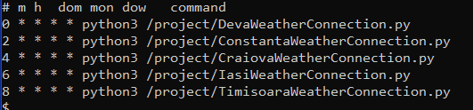
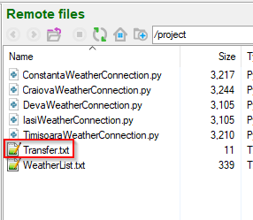
Linux: what else?
I created a new user “automation” which does not have sudo privileges. For security reasons, “root” was not involved. It is automation who runs the scripts.
Every city has its own script, running hourly, but at different minutes (0, 2, 4, 6 and 8). This was achieved using crontab.
All the information is written – line by line and in mode “append” - to the same WeatherList.txt file. If the script finds the “Transfer.txt” file in the folder, it means previous information was successfully transferred to Windows, so the buffer is no longer needed. Then and only then, the script erases both Transfer.txt and WeatherList.txt to restart the cycle of writing information to the buffer.

Slide 7
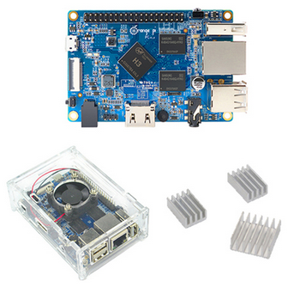
Why Linux?
In order to get regular information, I needed a server, i.e. a computer running non-stop.
A system-on-a-chip is a cheap way of setting a home server.
I used an Orange Pi PC running Ubuntu 20.04. It is very
small, unobtrusive and it needs 15 W max.
Linux automation is easy to set up with crontab.
Windows to Linux communication and control is
easy to set up using ssh.

Slide 8
2.
Windows machine

Slide 9
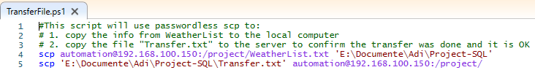
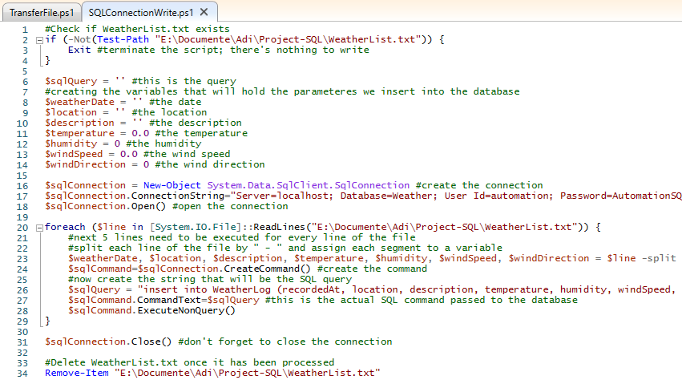
The scripts
There are 2 Powershell scripts:
Script #1 connects to Linux and copies via scp:
One file to Windows with the weather data
One file from Windows that tells Linux the data transfer was successful. The presence of this file in the Linux folder = “it is ok to erase the buffer”
5 minutes after the script above executes, the second script connects to the local SQL database (server = localhost) with the user “automation” and writes all the information from the file into the database (“insert into...”).
After closing the sql connection, it then deletes the WeatherList.txt file that is no longer useful, closing the data transfer loop.

Slide 10
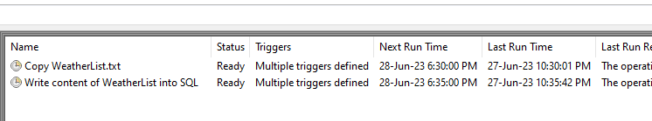
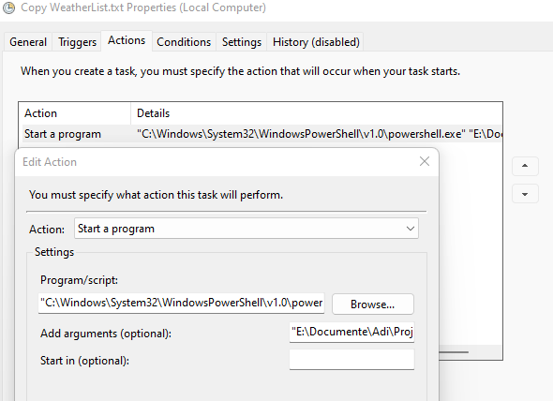
The automation
Windows automation is done with the Task Scheduler utility. Each script has its own task scheduled to run every afternoon and every evening. The second script (writing the content into the sql database) runs 5 mins after the first.
How to automate a Powershell script? The task action = “Start a program”, the program is Powershell.exe (just put the complete path to powershell.exe) and the argument is the script path (again, just put the whole path inside quotes). You can add the argument “-File” just before the path, but it is implicit. For some reason, Powershell really likes folders and files without spaces in the script path.
What happens if the computer is not on when the scripts are scheduled? Nothing, they wait for the next run time while the info is still being recorded in the Linux folder and file.

Slide 11
3.
SQL server and database

Slide 12
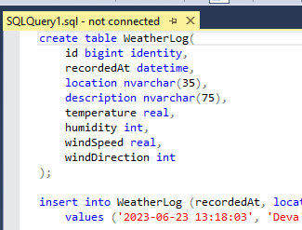
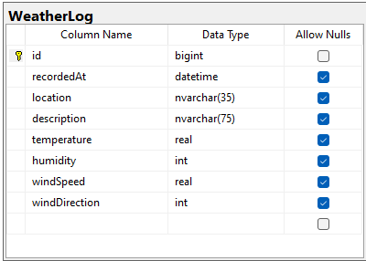
The database
The database has one table with 8 columns, the first one being an identity which is also primary key. I limited its size to 250MB, so as not to grow indefinitely.
For security reasons, I do not connect to the db with “sa”; I created a new “automation” user which had db_owner role and can only connect to this one database. The password for automation is used in cleartext in the Powershell script that connects to the database, so make sure to protect your “sa” user.
This database grows with 120 rows every day.

Slide 13
4.
Network and security

Slide 14
Network
The networking presents a difficulty: how to connect automatically from Windows to Linux? This is done using ssh via private / public key pair. For this, the basic steps are:
Install OpenSSH component for Windows 10/11. It’s an optional Windows component, so you may already have it. It has a server and a client, but I used the client (the Linux machine is the ssh server).
Use Powershell or cmd to generate a public / private rsa key pair with the command ssh-keygen. The private key is kept on the Windows machine and the public key is transferred to Linux. Instead of using a password, the ssh connection will compare the 2 keys. If they are identical, the connection will be allowed without a password.
Use the following command to add the public key to the authorized_keys file of the Linux user you are trying to connect to (in this case: automation)
The whole tutorial is found here: https://chrisjhart.com/Windows-10-ssh-copy-id/
Once this is done, the ssh and implicitly, scp commands work without a password and are, therefore, able to be executed automatic by a Powershell script

Slide 15
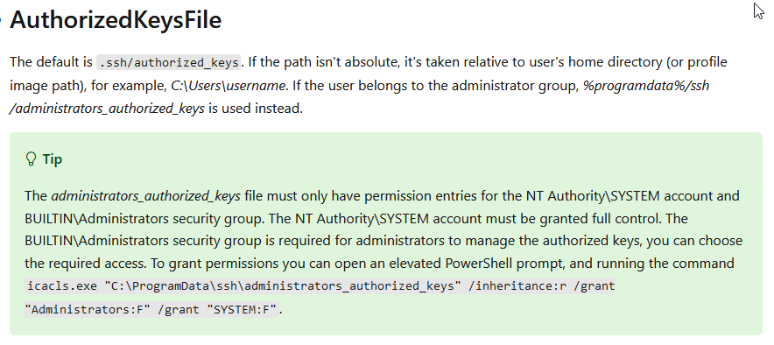
Network
Why Windows -> Linux connection and not the other way around?
It is easier. Linux integrates an ssh server by default
It makes more sense. SSH connection is from client to server and Linux is the server – the computer that is always on, the server that always listens on port 22
If you want to connect from Linux to Windows (which is, of course, doable with ssh), there are some extra steps in case your Windows account is an administrator – and it probably is. This needs a proper tutorial, but you can see some info here: https://learn.microsoft.com/en-us/windows-server/administration/openssh/openssh_server_configuration It’s the source of the photo below

Slide 16
Security
Always have security and good practices in mind. The security measures taken for this project are:
Use try / catch statements whenever a block of code may not run as intended. I used it for the API call to openweathermap.org. The API key may be wrong or no longer working, the server may be unresponsive, internet connection bugs... You do not want the script running indefinitely and / or possibly ruin the whole automation loop
Avoid using administrator / root accounts whenever possible.
I used a non-administrator (“automation”) account for the SQL server + the account only has access to one database. One of the reasons is that its password is used in cleartext in the Powershell script that connects to the database
I used a non-administrator (“automation”) account on Linux – with the proper rights to access folder, to write to file, to delete a file –, which are a headache to manage, as it is customary in Linux.

Slide 17
5.
How does it work again?

Slide 18
The logic
Linux operations 5x / hour:
Look in the project folder
If “Transfer.txt” file present (meaning previous data has been successfully transferred to Windows), then erase the Transfer.txt file and also erase the WeatherList.txt file containing now-useless data. Run the API call, re-create the WeatherList.txt file and write data in it.
If “Transfer.txt” file not present: simply run the API call and append the data to WeatherList.txt
Windows operations 2x / day:
Copy WeatherList.txt file from Linux
Put Transfer.txt file in the Linux folder to mark the successful transfer of data – so that the Linux script knows to erase old data.
Connect to the SQL database and write the data from the WeatherList.txt file
If the computer is not running and it misses 1,2...100 scheduled task runs, nothing bad happens. Data just accumulates on the Linux server in the file, awaiting next transfer.

Slide 19

Thanks!
All the files can be found in the public repository: https://github.com/adisirbu/SQL-Project-Public

